Slide 1
Classification of Biological Data - Common Crawl
Big Data Analytics

Slide 2

Problem we are looking to solve
The Common Crawl is an open repository of web crawl data collected over last 7 years which contains several petabytes of data.
This project aims to separate Biological data from other types which are not related to biology. It further aims at classifying the Biological data into different classes such as: human microbiome, carcinoma, infectious diseases, genetic diseases, etc.
The topics in biology are quite diverse and thus the documents may fall into one or more classes. Thus the classification is not disjoint.

Slide 3
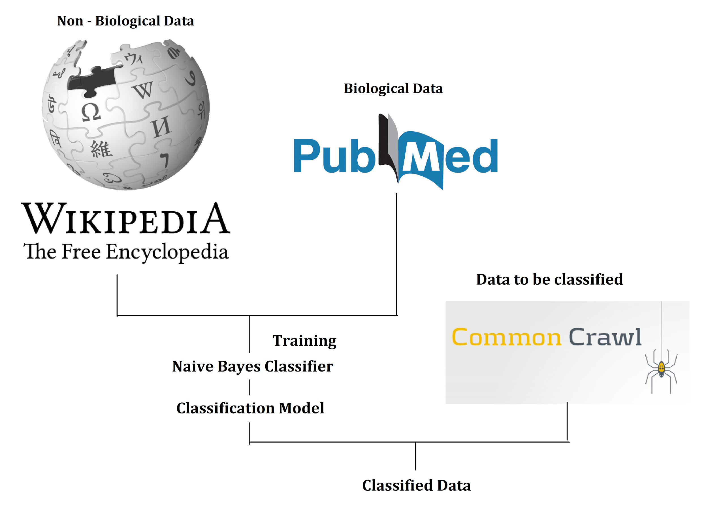
Architecture
Train the data with Non - Biological data from Wikipedia and Biological Data from PubMed using Naive Bayes.
Process archived common crawl files in parallel: unpack, process, delete unpacked version.
Classify Common Crawl data based on the classification model.
Use different categories in PubMed to classify data into different biological categories using parallel pipelines.

Slide 4




Technologies
Common Crawl data: stored on Amazon S3. We use Globus for data transfers.
ML pipeline: PySpark.
Storage: MongoDB (We wish to use this but we haven’t. For now we have stored them in folders on AWS s3.)

Slide 5
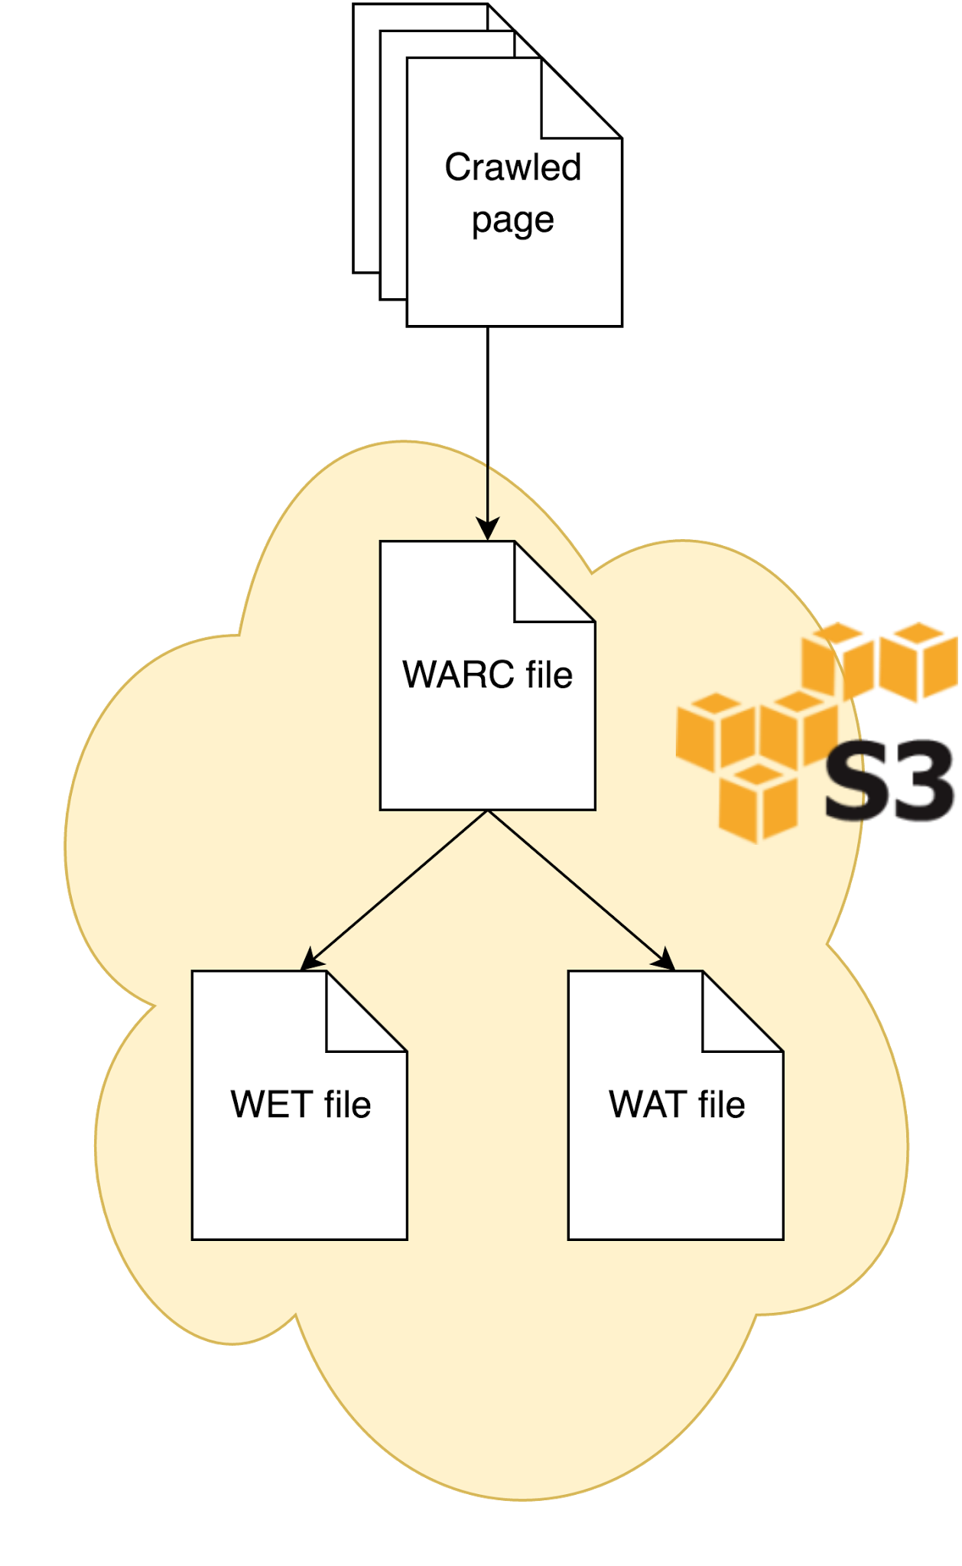
DataSets: Common Crawl
Stored as gzipped archive files, with many pages in each file
3 main file formats: WARC, WAT and WET.
WET contains the extracted page text, could be useful for classification.
Extraction algorithm is available online, but probably hard to implement in a Spark pipeline.
Other possibility: strip HTML ourselves. (Get rid of XML like structure)

Slide 6

DataSets: Wikipedia for Non-Biology
We have used the English documents from the Wikipedia Dataset used by the LORELEI classification project for training of Non - biology documents.
Enwiki-latest-pages-articles-multistream.xml
extracted by WikiExtractor.py
There are 5297852 articles in this dataset.
We have not separated the biology articles from the non - biology ones.
(The separation must be done in order to achieve better results. This is a part of the future work as we don’t currently have pure non-biology data set to train the classifier .)

Slide 7

DataSets: PubMed for Biology
We have used the PubMed articles to train our classification model for Biology related documents.
These PubMed articles can be further categorized into classes specific to different topics in biology such as: Microbiome, Cancer, Infectious diseases, Genetic Diseases, Gene Therapy, etc.
The articles were extracted from ftp://ftp.ncbi.nlm.nih.gov/pub/pmc/oa_bulk/

Slide 8
Pipeline
Data retrieval and preprocessing using custom Bash+Python scripts
Actual classification implemented in pySpark
Preprocessed Articles → Punctuation Stripper → Tokenizer → N-Gram Features → CountVectorizer → NaiveBayes
Part A : Classification of Non-biological data from Biological data
N - gram model used : Unigram
Part B: Classification of Biological Data into other Bio related categories (Microbial, Cancer and others)
N - gram model used : Trigram and Four-gram
The microbiome subset of data was too small for training, hence we have used microbe data from PubMed.

Slide 9
Result - Small Test Data Set (Confusion Matrix)
 | bio | other | total
bio | 86193 | 2100 | 88293
other | 2712 | 65833 | 68545
 | microbial | cancer | other | total
microbial | 69 | 3 | 47 | 119
cancer | 0 | 63 | 64 | 127
other | 6 | 4 | 282 | 292

Slide 10
Result - Full Data Set (Confusion Matrix)
 | bio | other | total
bio | 9402063 | 650493 | 7659957
other | 746637 | 6913320 | 10052556
 | microbial | cancer | other | total
microbial | 222007 | 16391 | 282559 | 520957
cancer | 17743 | 256881 | 282782 | 557406
other | 47922 | 42102 | 504066 | 594090

Slide 11
Result - Performance (Bio and Non-Bio)
 | Small Data Set | Full Data Set
Test Error | 0.0306813399814 | 0.0788781354741
Runtime | Less than 10 minutes on: master(m4.large), 2 core(m4.xlarge) | Less than 20 minutes on: master(r3.2xlarge), 10 core(r3.2xlarge)

Slide 12
Result - Performance (Microbes - Cancer - Other)
 | Small Data Set | Full Data Set
Test Error | 0.230483271375 | 0.412268087653
Runtime | Less than 10 minutes on: master(m4.large), 2 core(m4.xlarge) | Less than 20 minutes on: master(r3.2xlarge), 10 core(r3.2xlarge)

Slide 13
References
Common Crawl Data Format
PubMed FTP Service
The Wikipedia dataset
Thank You!

